Slide 1
Biltz TensorFlow Object Detection Set up
Reference:
https://gilberttanner.com/blog/creating-your-own-objectdetector
https://github.com/TannerGilbert/Tutorials/tree/master/Tensorflow%20Object%20Detection
https://github.com/PINTO0309/MobileNet-SSDLite-RealSense-TF/tree/v1.0

Slide 2
1. Preliminary Program and Package Install
Programs:
Install python
Install anaconda
Install Spyder
Packages:
Open anaconda -> Spyder
Run the following in the cmd prompt on the side
pip install tensorflow ==1.15.0
pip install --user Cython
pip install --user contextlib2
pip install --user pillow
pip install --user lxml
pip install --user jupyter
pip install --user matplotlib

Slide 3
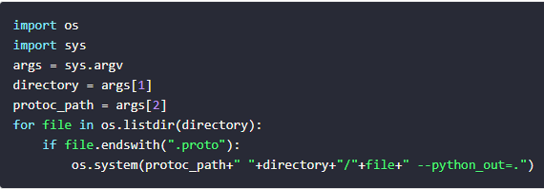
2. Download and Install Object Detection & Protobuf
Object Detection Repository:
Download models-masters from here
Extract and rename to just models
Install COCO API: (COCO is a large image dataset designed for object detection)
Open anaconda -> Spyder
Run the following in the cmd prompt on the side
pip install "git+https://github.com/philferriere/cocoapi.git#egg=pycocotools&subdirectory=PythonAPI"
Protobuf:
Download latest version here
Extract and place the folders inside models->research
Convert proto to py
Create new .py script in research folder
Paste the code on the right
Run following in cmd prompt inside research folder
python use_protobuf.py object_detection/protos “your directory”/models/research/bin/protoc

Slide 4
3. Running Setup
Run following in cmd prompt inside research folder:
Python setup.py build
Python setup.py install

Slide 5
4. Test basic object detection
Open anaconda
Run Jupyter note
Navigate to models->research->object_detection
Open object_detection_tutorial.ipynb
Modify code to match file with ppt folder
Cell->Run All

Slide 6
5. Object Detection w/ Live Camera
Install OpenCV Package:
Open anaconda
Open Spyder
Cmd prompt: conda install OpenCV
Make a copy of Open object_detection_tutorial.ipynb and name it object_detection_cam.ipynb
Modify code to match file with ppt folder
Cell->Run All

Slide 7
6. New Model Training 1
Test images
Gather various images of the object(s) you want to detect
Try to use various backgrounds and orientations
Create an images folder insider object_detection
Create a test and train folder inside images folder
Spilt 80% of images into train and 20% into test folder
Label images
Download image labelling software here
Extract and execute .exe
Open your models-research->object_detection->images->train directory
On each image create a rectbox and label image with what you want it to be identified as
Hit save and let it save as xml (default) to the same directory as the image

Slide 8
6. New Model Training 2
Converting labelled image data
Go to following Github and copy xml_to_csv and generate_tfrecord script into models->research->object_detection folder
Run following in cmd prompt inside object_detection folder:
python xml_to_csv.py
This should create a train_labels.csv and a test_labels.csv
Modify generate_tfrecord script to match the one provided
Edit class_text_to_int function to whatever you want detected (use elif if you have more than one detection)
Run following in cmd prompt inside object_detection folder:
python generate_tfrecord.py --csv_input=images/train_labels.csv --image_dir=images/train --output_path=train.record
python generate_tfrecord.py --csv_input=images/test_labels.csv --image_dir=images/test --output_path=test.record
These two commands generate a train.record and a test.record file which can be used to train our object detector

Slide 9
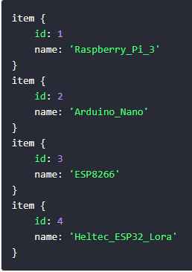
6. New Model Training 3
Label map
Create a training folder inside models->research->object_detection
Create a new file called labelmap.pbtxt (use Spyder to edit it)
Add your detection items inside file using the structure on the right
Training model
Go into models->research->object_detection->samples and copy whatever model you want to train with into the training folder
Download whatever sample model you want to use to train your model from here and place into object_detection folder
Extract twice
Place the .config file into the training folder
Open the .config file using Spyder
Update number of class to the number of objects you want to detect
Update fine_tune_checkpoint: to point to model.ckpt inside the newly extract folder
Update input_path under train_input_reader: to point to train.record in object_detection folder
Update input_path under eval_input_reader : to point to test.record in object_detection folder
Update label_map_path under train_input_reader : to point to labelmap.pbtxt inside training folder
Update label_map_path under eval_input_reader: to point to labelmap.pbtxt inside training folder

Slide 10
6. New Model Training 4
Training Model Cont’d
From inside object detection folder run cmd prmt:
python model_main.py --logtostderr --model_dir=training/ --pipeline_config_path=training/faster_rcnn_inception_v2_pets.config
Training process will begin in a little bit
Wait till TotalLoss to be less than 0.05 (can take some time)
Hit cntrl + C to stop the training
Export new inference graph
From inside object detection folder run cmd prmt:
Python export_inference_graph.py --input_type image_tensor --pipeline_config_path training/faster_rcnn_inception_v2_pets.config --trained_checkpoint_prefix training/model.ckpt-XXXX --output_directory inference_graph
*Change the highlighted to whatever model you used
*Change the highlighted to whatever model you used
*Change the highlighted to the max model number your training reached

Slide 11
7. New Model Setup in Jypter Notebook
Make a copy of Open object_detection_cam.ipynb and name it object_detection_cam_own_model.ipynb
Update:
MODEL_NAME = 'inference_graph'
PATH_TO_FROZEN_GRAPH = MODEL_NAME + '/frozen_inference_graph.pb'
PATH_TO_LABELS = 'training/labelmap.pbtxt’
Cell->Run All

Slide 12
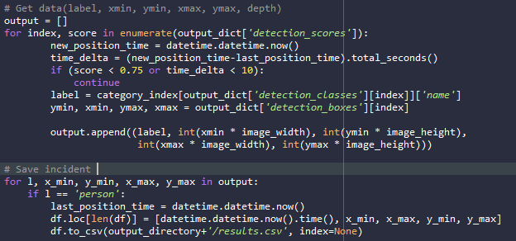
8. Position Output 1
Output directory for results:
output_directory = 'C:/Users/karan/Desktop/PreceptionTrial/models/research/object_detection/results’
os.makedirs(output_directory, exist_ok=True)
Time delta setup to only output position every 10 seconds:
last_position_time = datetime.datetime.now()
time.sleep(10)
new_position_time = datetime.datetime.now()
Position output:
Code block on the top right of the screen
Example file can be found “Object_detection_cam_position.py”

Slide 13
9. Intel Realsense Integration
Open anaconda -> Spyder
Run the following in the cmd prompt on the side
pip install pyrealsense2
SAVE A COPY OF visualization_utils.py (inside object_detection->utils)
Update visualization_utils.py to match the one found https://github.com/PINTO0309/MobileNet-SSDLite-RealSense-TF/tree/v1.0
This add depth as a new parameter to the output
Create new detection script to match “detection_depth_trail_3.py”

